Slide 1
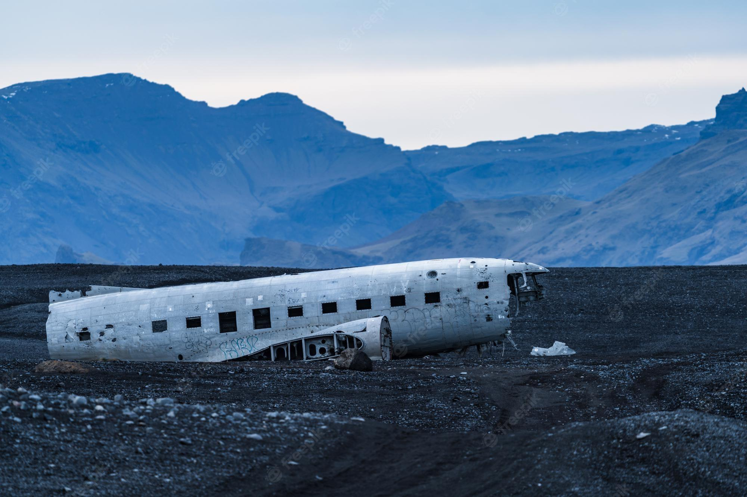
Aircraft accidents
By Group 17

Slide 2

Why did we chose this topic?

Slide 3
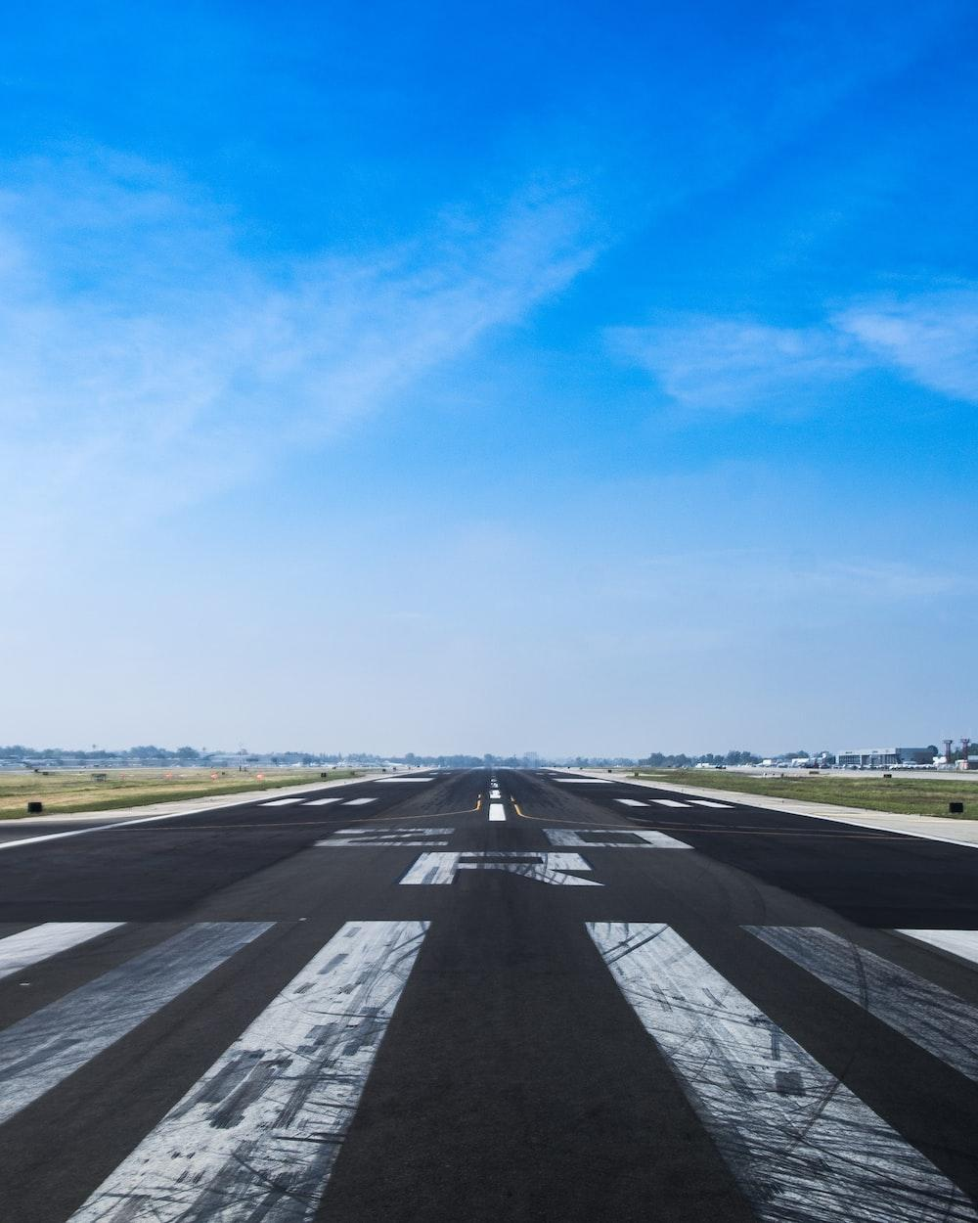
How the data was collected?
Researching different websites
Web scraping the entire page using R programming language, more specifically using library called rvest.
Cleaning the data using libraries like stringr.

Slide 4

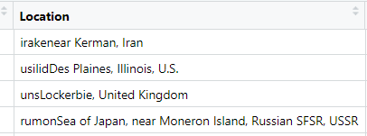
Challenges faced while collecting the data
Cleaning the dataset
Creating new columns
For example:
Before

Slide 5
Challenges faced while collecting the data
Cleaning the dataset
Creating new columns
For example:
Before

Slide 6
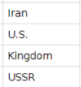
Challenges faced while collecting the data
Cleaning the dataset
Creating new columns
For example:
Before

Slide 7
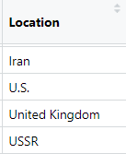
Challenges faced while collecting the data
Cleaning the dataset
Creating new columns
For example:
Before

Slide 8

About the Data
The Final Dataset contains the record of Aircraft accidents happened between 1938 to 2022. It contains 544 observations of 9 variables.
These variables are:
Total deaths
Crew deaths
Passengers death
Ground deaths
Plane type
Aircraft name
Country of accident
Phase of accidents
Date

Slide 9

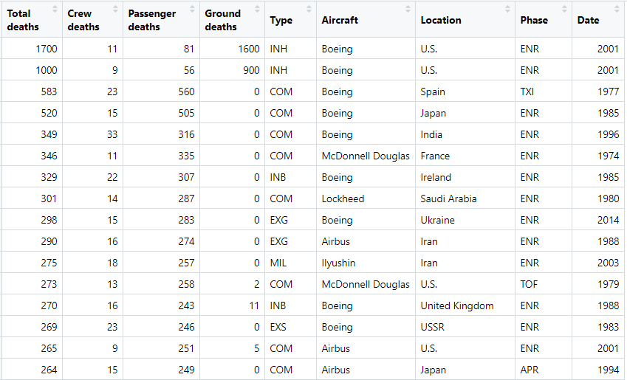
A glimpse of our data set

Slide 10
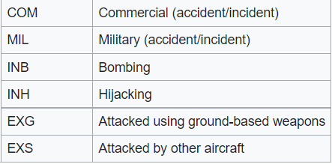
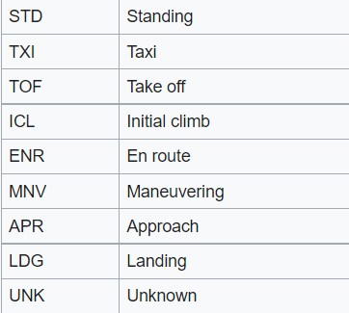

Slide 11

Key questions of interest
How is the deaths related to different parameters?
What is the trend of no. of deaths with respect to time?
Which airline company is safest to travel ?
Which manufacturer made the most improvement with respect to time?

Slide 12
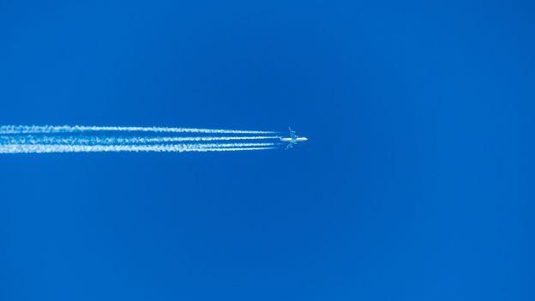
PLOTS

Slide 13
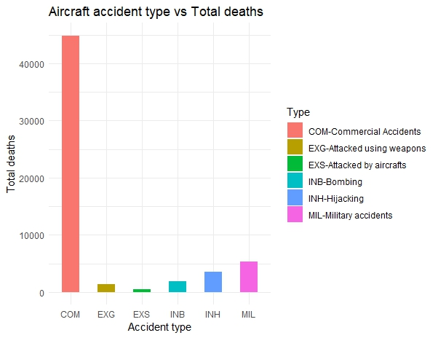
Plots

Slide 14
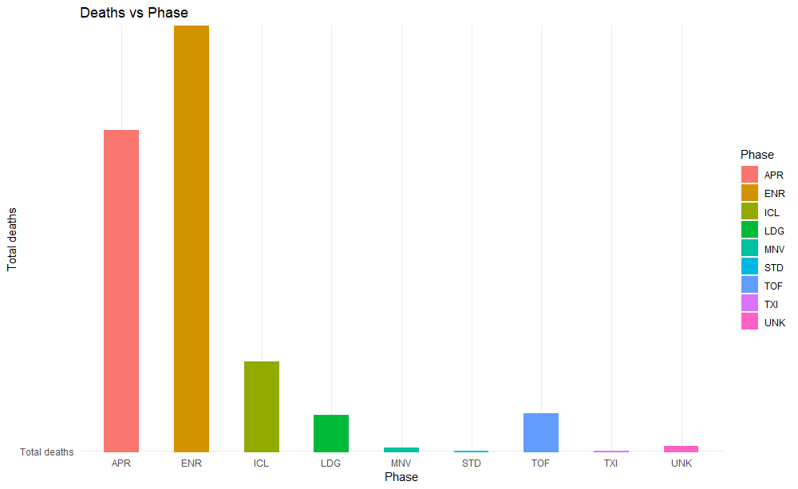
Plots

Slide 15
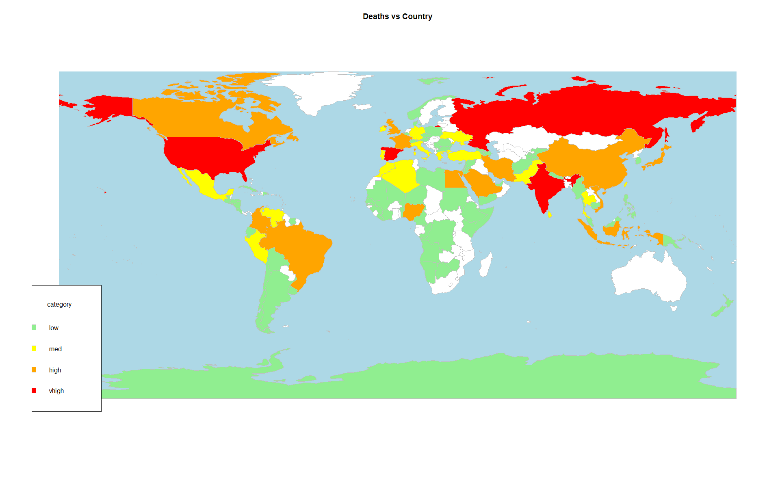

Slide 16
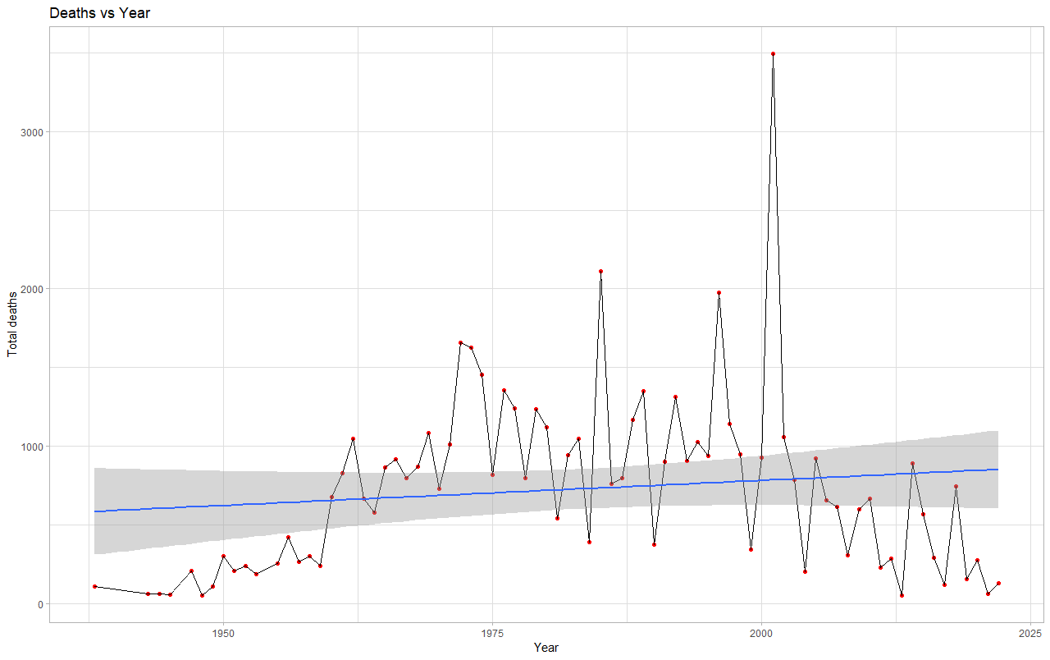

Slide 17
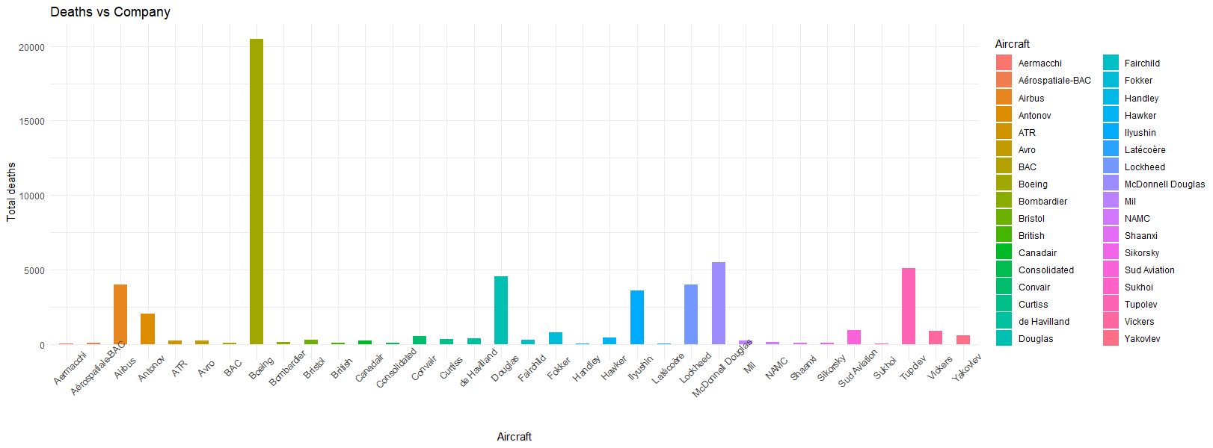
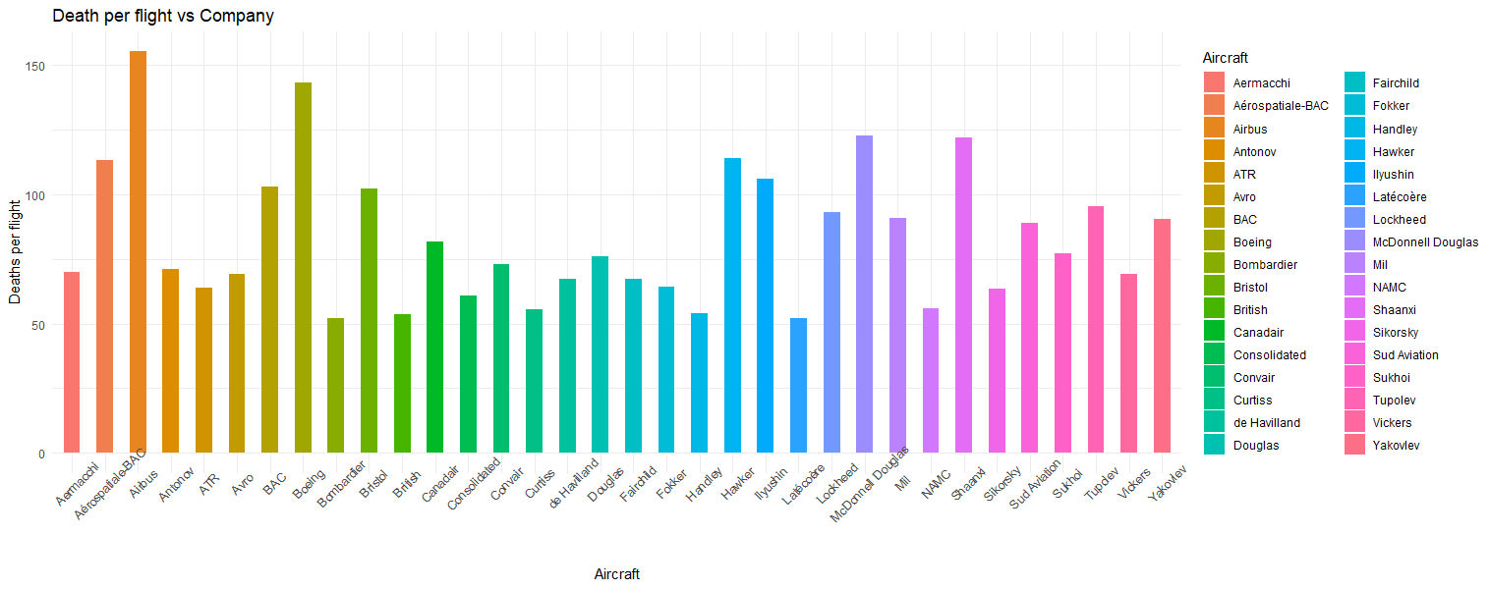

Slide 18
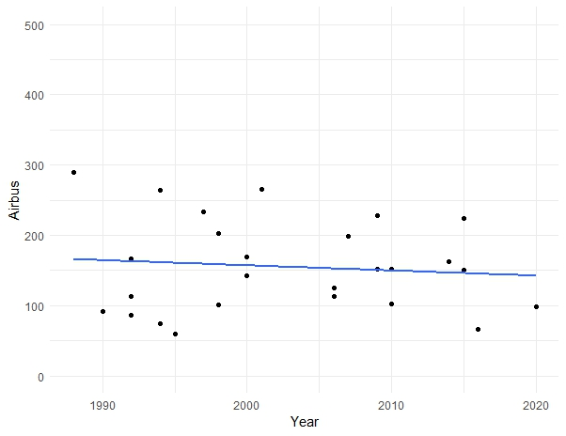
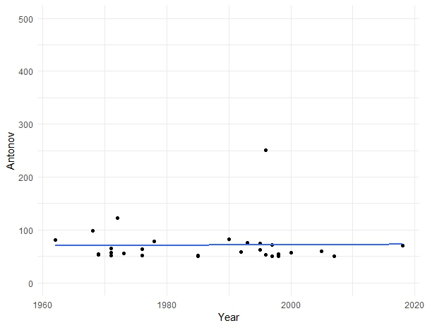
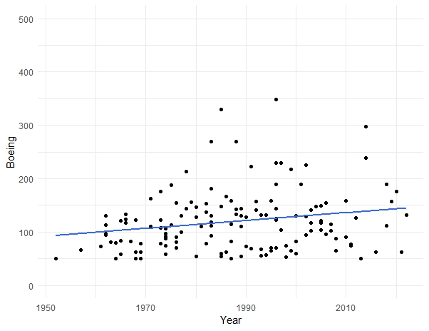
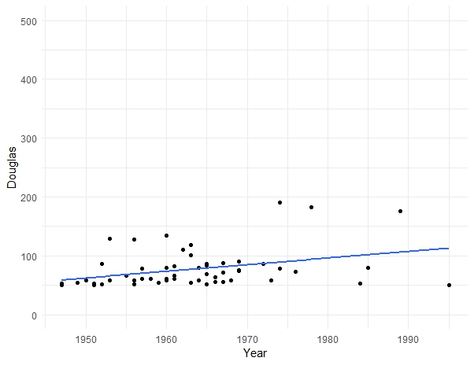
Antonov
Airbus
Boeing
Douglas

Slide 19
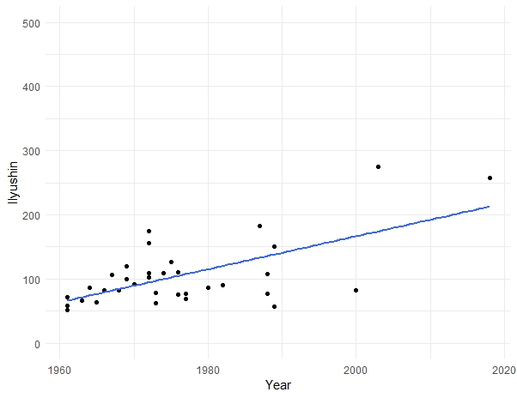
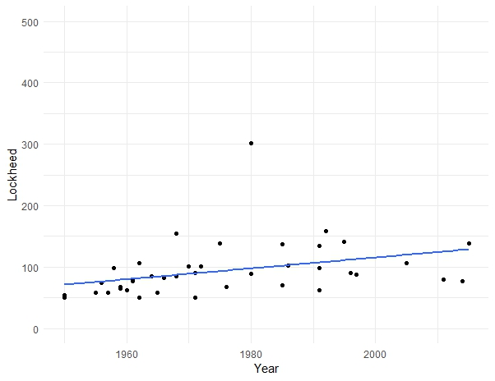
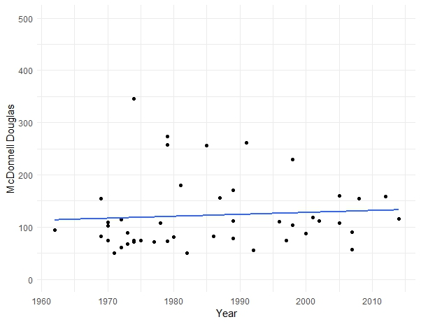
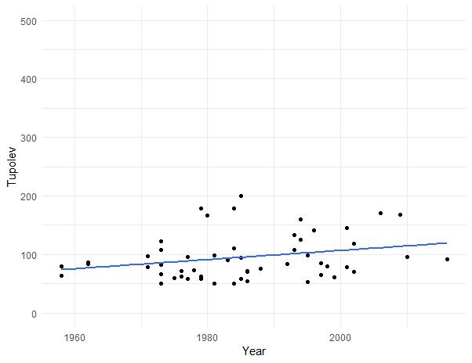
Airbu
Antonov
Ilyushin
Lockheed
McDonnell Douglas
Tupolev

Slide 20

Shiny app

Slide 21
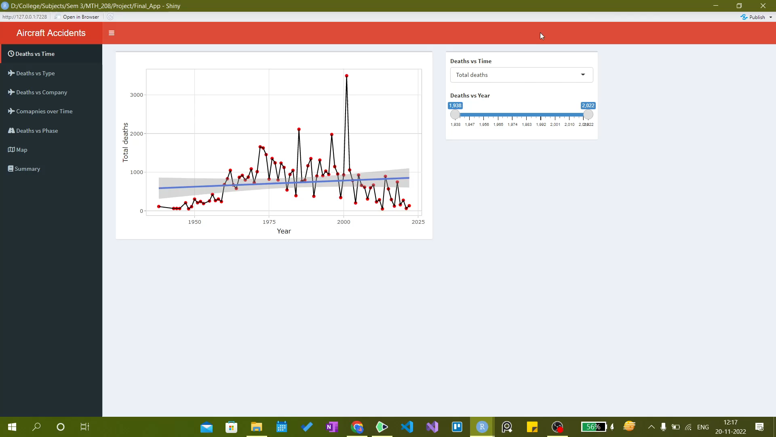
Shiny app

Slide 22
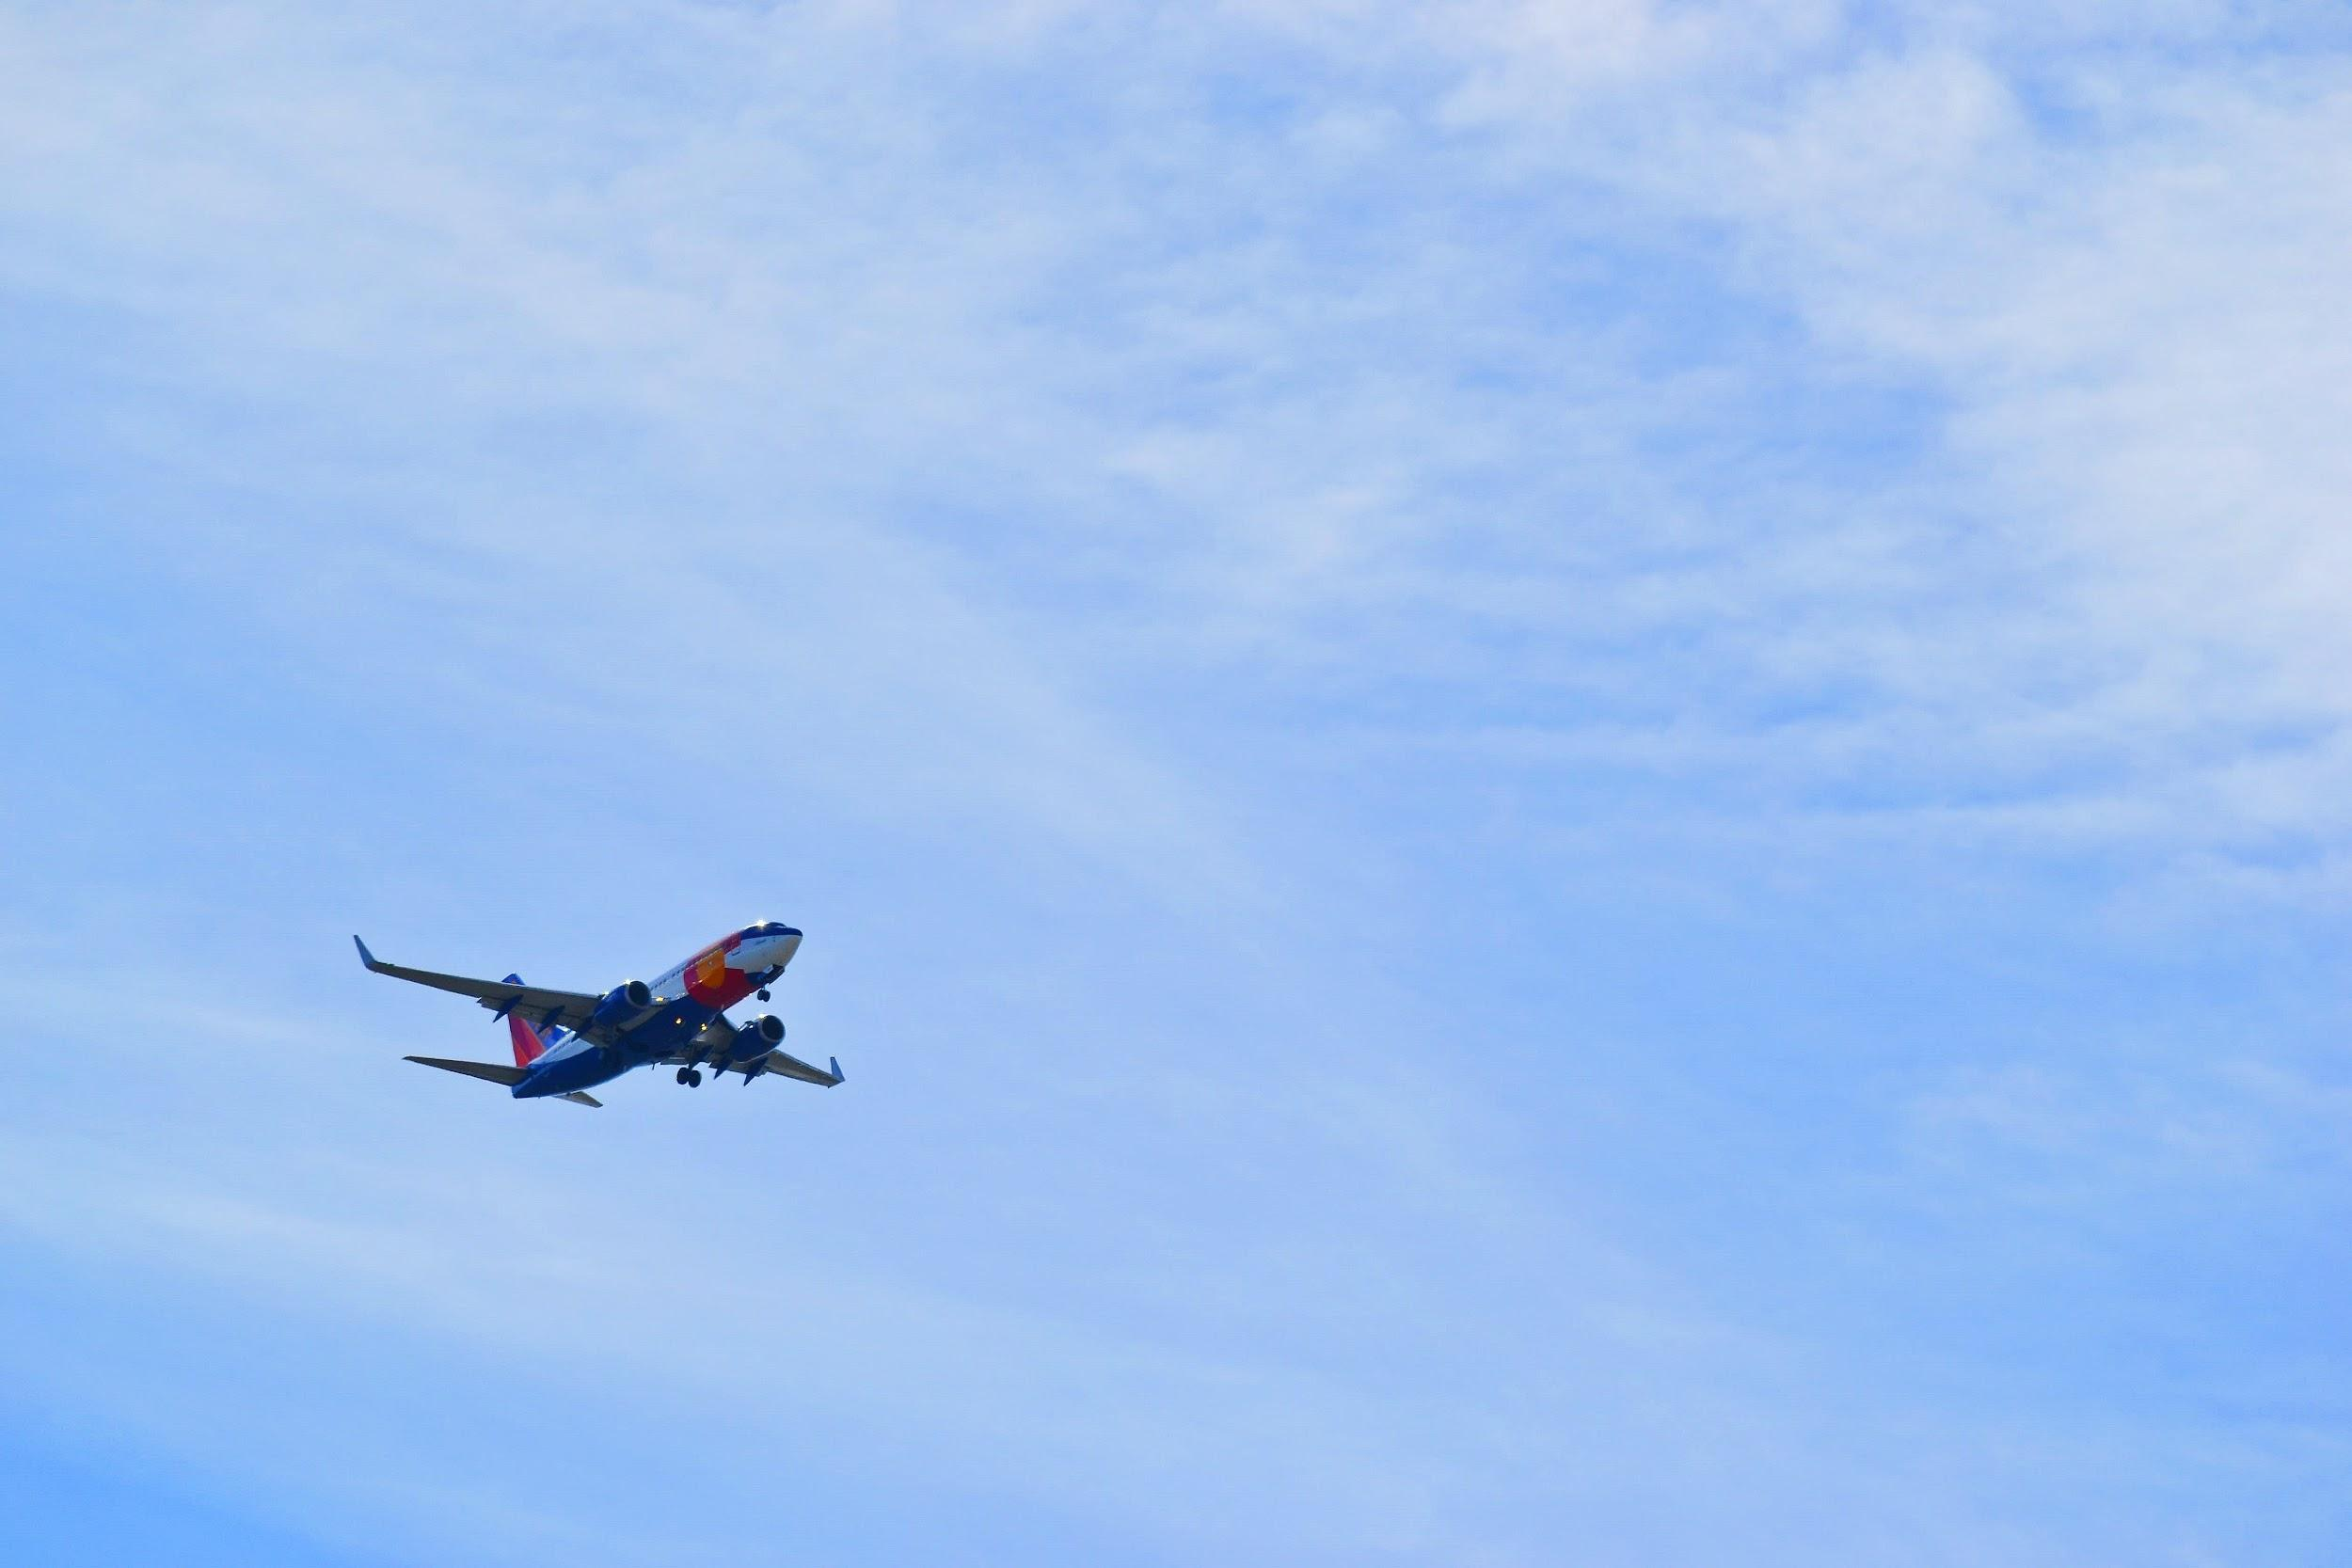
Conclusions

Slide 23
Conclusions
Accidents during the en-route phase is most the dreadly while those during standing phase is not that significant.

Slide 24
Conclusions
Accidents during the en-route phase is most the dreadly while those during standing phase is not that significant.
Commercial aircraft accidents is the most common.

Slide 25
Conclusions
Accidents during the en-route phase is most the dreadly while those during standing phase is not that significant.
Commercial aircraft accidents is the most common.
Aircrafts manufactured by Airbus has the most deaths per flight while those manufactured by Bombardier and Latecoere has the least deaths per flight.

Slide 26
Conclusions
Accidents during the en-route phase is most the dreadly while those during standing phase is not that significant.
Commercial aircraft accidents is the most common.
Aircrafts manufactured by Airbus has the most deaths per flight while those manufactured by Bombardier and Latecoere has the least deaths per flight.
Airbus have made more improvements in their aircrafts as compared to others.

Slide 27
Limitations
Data was insufficient.
Data has only considered accidents which have caused 50 or more deaths.

Slide 28
References
Data source: https://en.wikipedia.org/wiki/List_of_deadliest_aircraft_accidents_and_incidents
Plot reference: http://r-statistics.co/Top50-Ggplot2-Visualizations-MasterList-R-Code.html

Slide 29
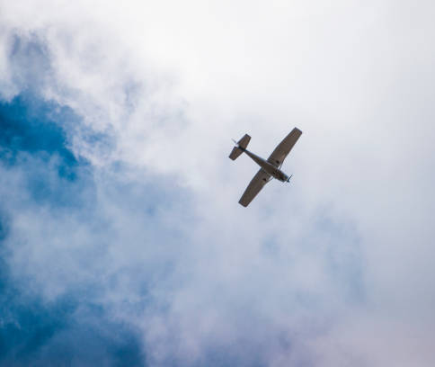

Thank You
MADHUR BANSAL
SAMBIT DAS
SONALI SAREN
Thanking Dootika mam and TAs

